Slide 1
Y9 INV 2 – Sampling & Distribution
Henry Sun

Slide 2
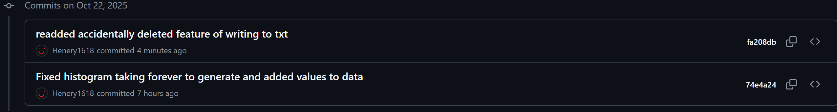
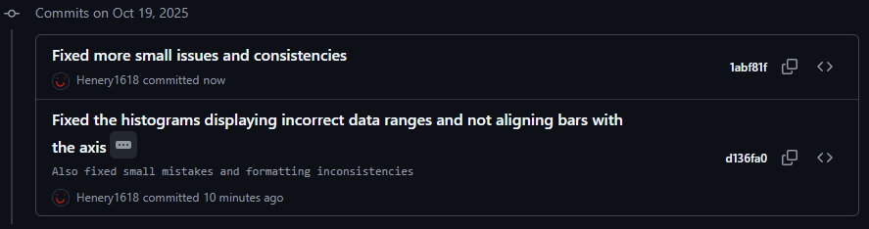
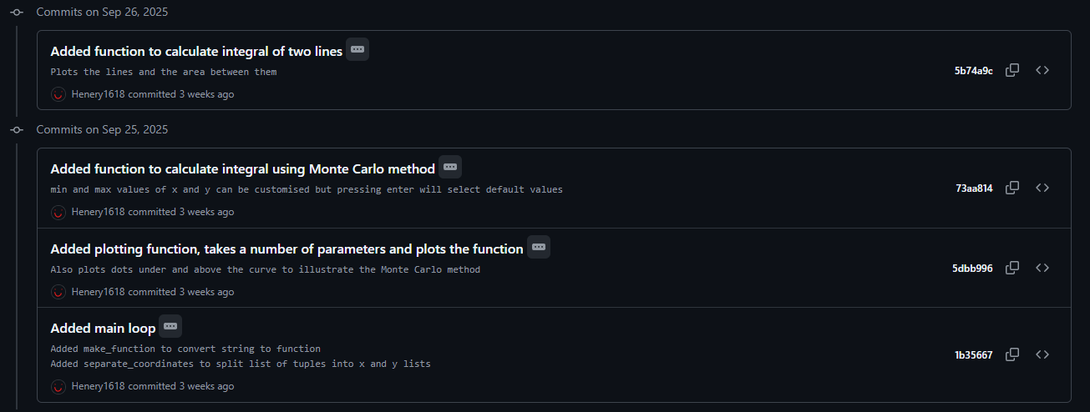
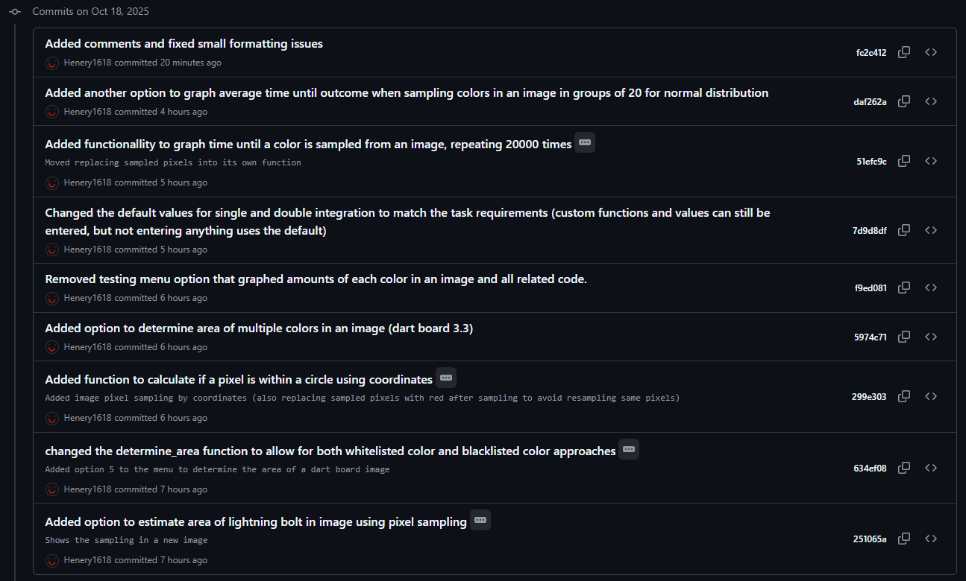
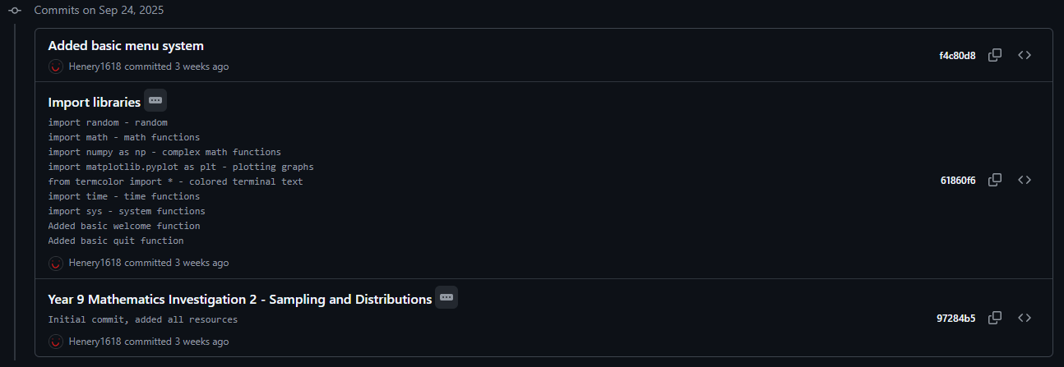
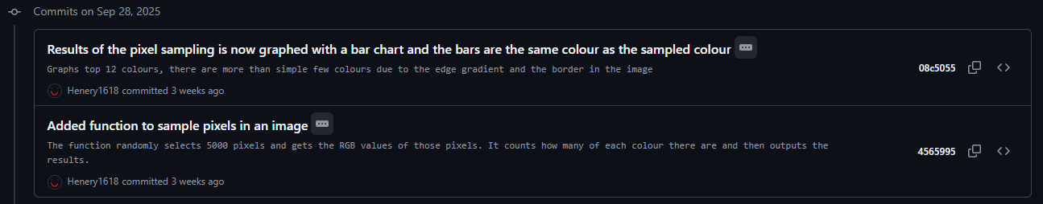
Commits

Slide 3
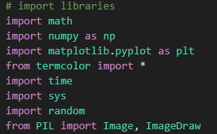
0. Prelim stuff
I used these libraries:
Math – for math functions
NumPy – Vectorizing & other math stuff
MatPlotLib – Plotting graphs
TermColor – Colored outputs
Time – Time related features
Sys – Exiting program
Random – Randomising stuff (yes math and numpy can do this but I forgot)
PIL – Image reading and modification

Slide 4

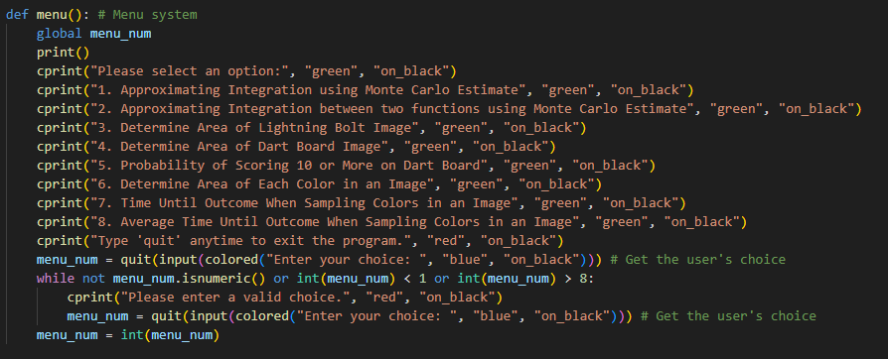
Approach
For this task, I have combined everything into one file, using a menu system
There is a loop at the end to execute programs depending on the menu number (example to the right)

Slide 5
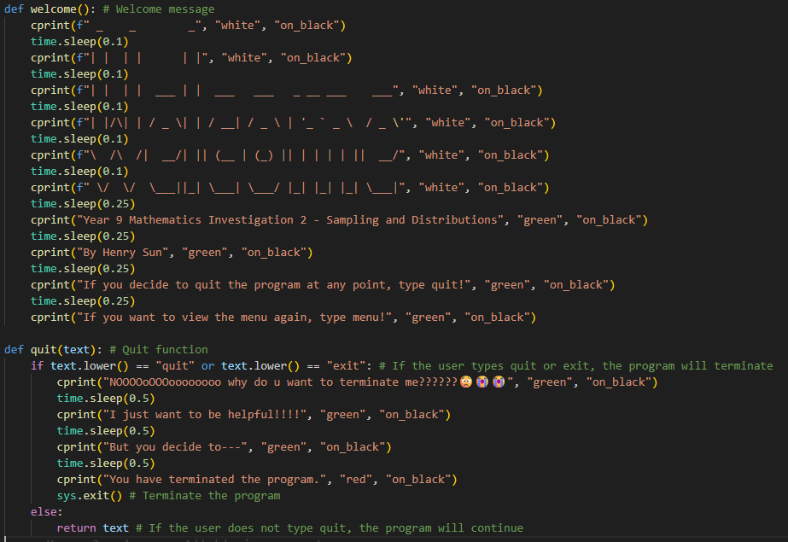
Other
Welcome message and quit function
(ive had this since year 7 first inv so I just decided to keep it :D)

Slide 6
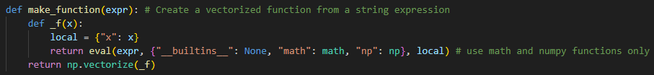
1. Approximating Function Integration Using Random Selection
Firstly, the make_function(expr): function creates a vectorized function from a string expression
Or in other terms it creates the line in an efficient way from an input
The underscore in the function name is just a formatting style for local functions
This second last line evaluates the function with the math and numpy libraries to enable functions such as math.tan(x), etc
(yes I know this wasn’t required)

Slide 7
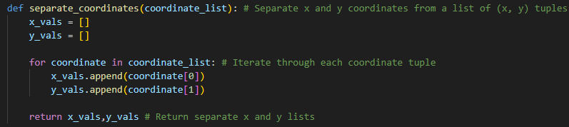
1. Approximating Function Integration Using Random Selection
The function separates tuples (unmodifiable values in brackets, eg (6,7)) into lists of x coordinates and y coordinates
For example if I have this list of coords:
coords = [(0, 1), (2, 3), (4, 5), (6, 7)]
After running it through the function with seperate_coordinates(coords)
It would return:
x_vals = [0, 2, 4, 6]
y_vals = [1, 3, 5, 7]

Slide 8
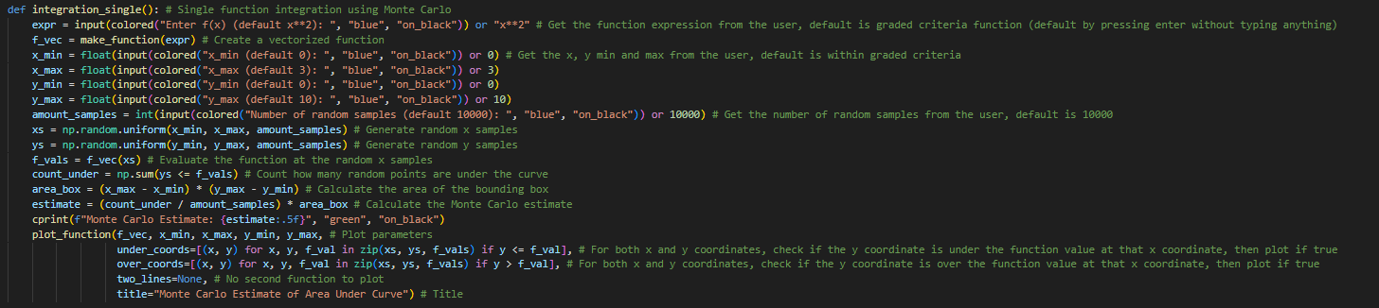
1. Approximating Function Integration Using Random Selection
This is my function for calculating the integral of a single line (yes I didn’t realise they gave it for free)
The following slides are explanation
This was changed to 9

Slide 9
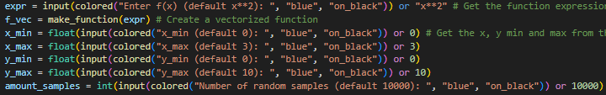
Inputs
These lines take in inputs for the function (expr), and the minimum and maximum x and y values, x_min, x_max, y_min, y_max and the amount of samples amount_samples
The “or” just means when you press ender without entering anything, it automatically sets it to the value
The presets I added are following 1.1.2 problem 2
f_vec creates the vectorized function with the make_function(expr) function

Slide 10
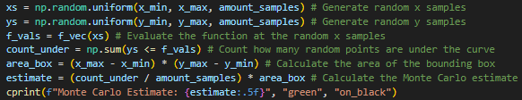
Calculations
This generates random coordinates, and calculates the integral with the monte carlo estimate

Slide 11

Graphing
plot_function() first takes the line (f_vec), graph limits (x_min, x_max, y_min, y_max),
Then, for both x and y coordinates and f_val, it checks if the y coordinate is under the function value, therefore the coordinates under the line
Then it does the same for above the line

Slide 12
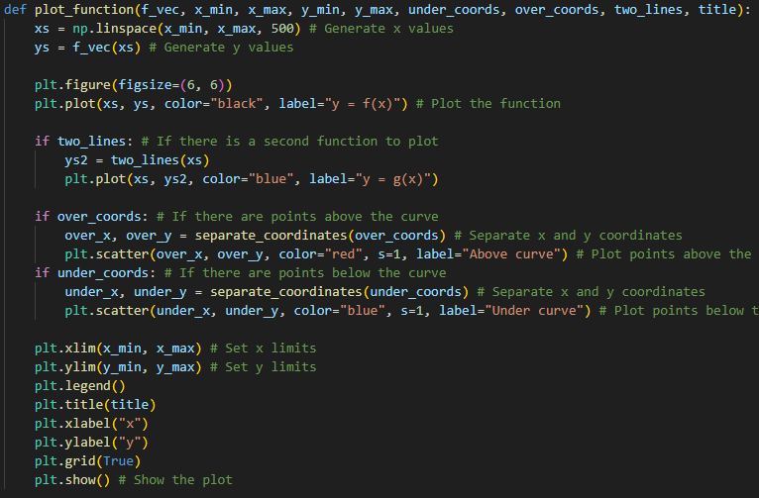
Graphing
This is my function to plot a graph, for both single and double integration, plot_function()

Slide 13
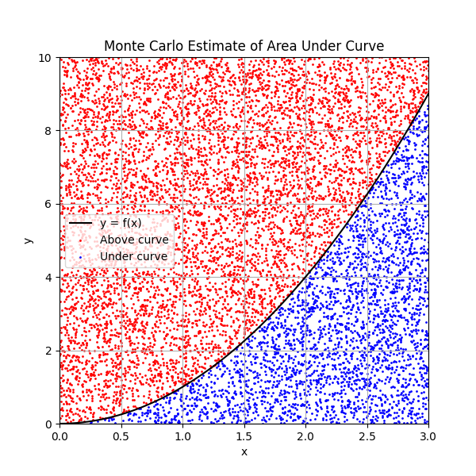
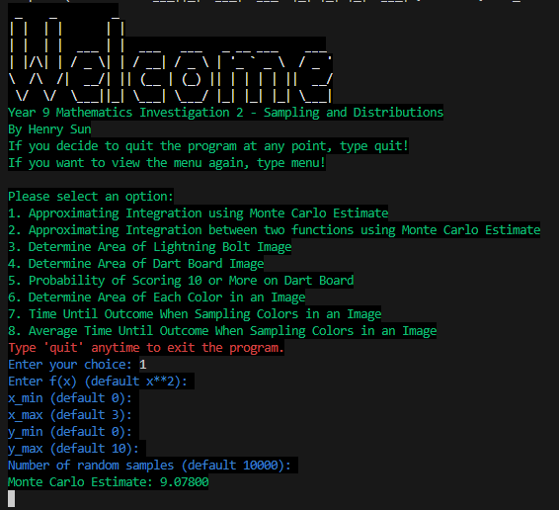
1.1.2. Problem 2 Output
This is an example of an output
The results seem to be ~9

Slide 14
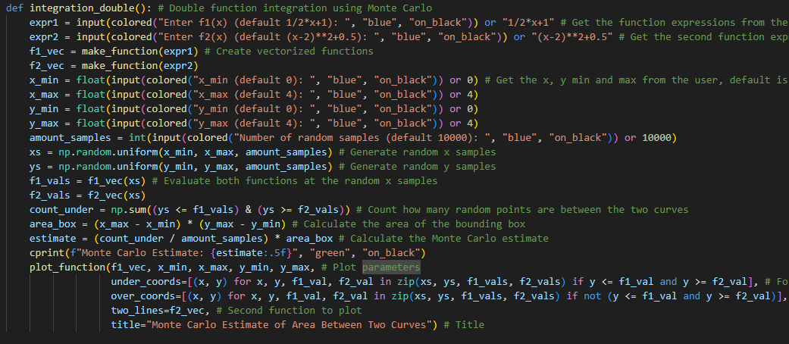
Integration of two lines
integration_double() is very similar to integration_single(), only adding functionality for calculating between the lines instead

Slide 15
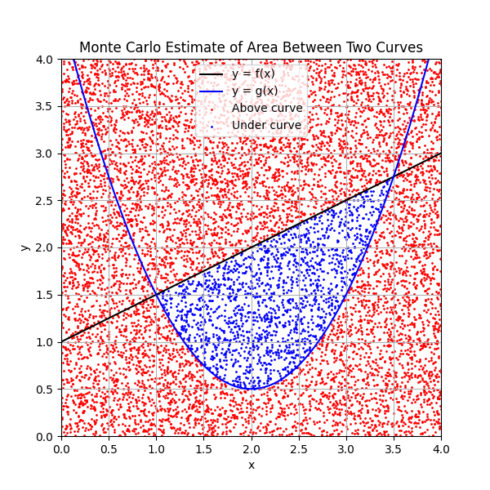
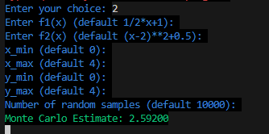
1.1.3. Problem 3 Output

Slide 16
1.2. Sampling Pixel Values from an Image
• How is colour represented in the image?
Colour is represented with rgb tuples, red green blue values ranging from 0-255 each, eg (255, 255, 255)
• What number ranges are used? Colour can range from 0-255 in each rgb value
• How was colour changed in the image? Sampled pixels were set to (0, 0, 255), pure blue
• How can you check the colour of a pixel in the image? Eyedropper, it returns a hex code or rgb value
• How could you identify if a region of a particular image is a certain colour?
Sampling pixels across the region and use an eyedropper to find the rgb value of each. If they match, the colour is consistent.

Slide 17
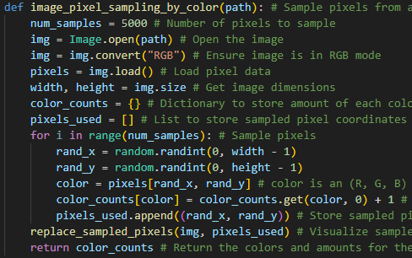
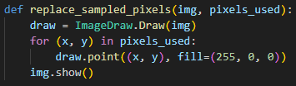
Sampling - Colors
image_pixel_sampling_by_color() samples 5000 pixels and gets the color of them, while saving the coordinates in pixels_used
The color data is stored in color_counts, such as:
color_counts = {(0, 0, 0): 6, (255, 255, 255): 5}
This means there are 6 black (255,255,255) and 5 white (0,0,0) pixels
After sampling the pixels, it calculates the percentage
Then it replaced the sampled pixels with red (255,0,0) with the replace_sampled_pixels() function.
The reason I replace pixels after, is because if a pixel gets chosen after it has been chosen and replaced already, it’ll count it as red.

Slide 18
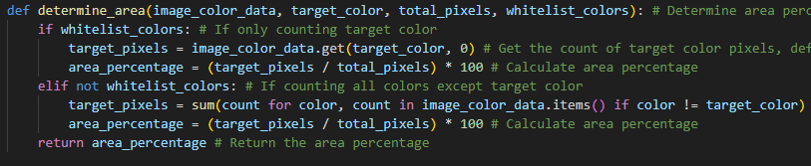
Determining area/percentage
determine_area() calculates the percentage of the pixels sampled that are a specific color (whitelist) or all pixels not a specific color (blacklist)

Slide 19


2.1.1. Determining Area Result
Then, bolt_percentage is calculated, with (255,255,54) as the color of the bolt, 5000 samples and the whitelist filter (therefore treating all other colors including the grey border as the background)

Slide 20
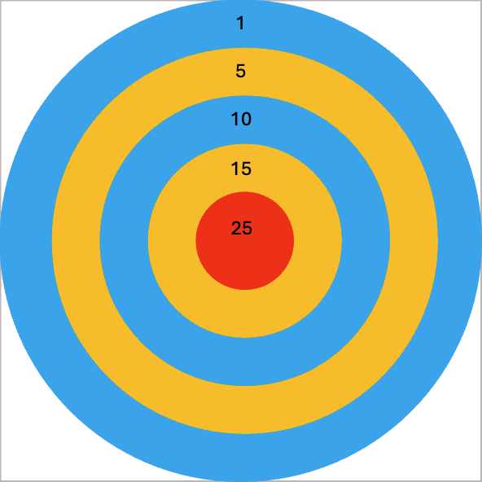

3. Image based sampling
3.1.1 Ratio of board to scoring area
Assuming that the diameter is equal to the width or height of the image (1 unit in this case), we can calculate the area
$A=πr^{2}$
R = 0.5
A = ${0.5}^{2}$𝜋
A = 0.25𝜋 OR 𝜋/4
Area of scoring area to board 𝜋/4:1

Slide 21
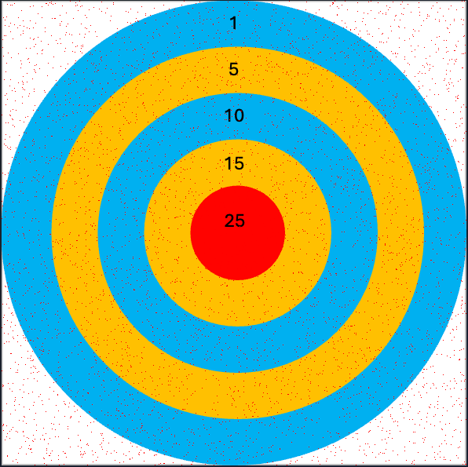
3.1.2. Appoximate Ratio Result
To estimate the area of the dartboard, I used the exact same function as to estimate the area of the bolt
However, this time it uses blacklist, meaning all colors except for this background color (255, 255, 255), also counting the black text as part of the board
I calculated the exact value to be 𝜋/4, or around 79%

Slide 22

3.1.3. Probability of Scoring 10 or more - Exact
If the inner red circle has a radius of $r_{1}$, and each circle on the board is larger than the immediately smaller circle by 2 $r_{1}$. Work out the exact likelihood that a person will score 10 or more.
$r_{1}$= 1
$r_{3}$=3
$d_{5}$=10
Total area = 100
P(scoring 10 or more) = $3^{2}π$/100
P(scoring 10 or more) = 0.09 $π$

Slide 23
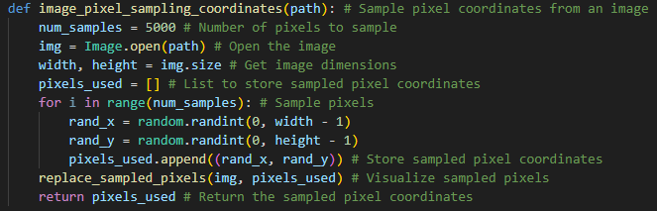

Sampling coordinates
Image_pixel_sampling_coordinates() samples 5000 random points, saving the coordinates in pixels_used
Replaced_sampled_pixels() is the function before that visualizes the sampling
within_circle() checks if a coordinate is within a circle using squared distances

Slide 24
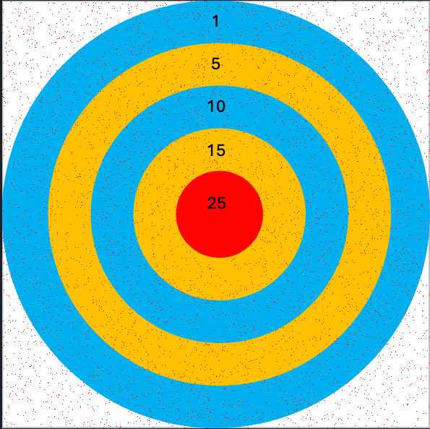


3.1.4. Probability of scoring 10 or More - Results
First, it calculated the radius of the 10 point circle (r3), gets the center_x and center_y
Then, using image_pixel_sampling_coordinates(), points are sampled and it checks if they are within the circle with within_circle()
The exact value is 0.09$π$, which is around 28.27%

Slide 25
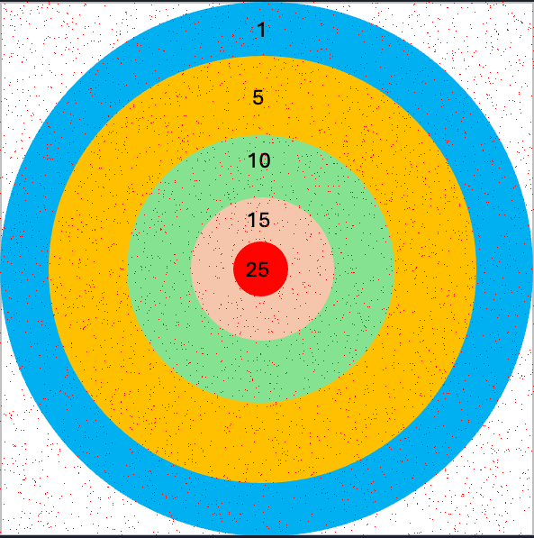
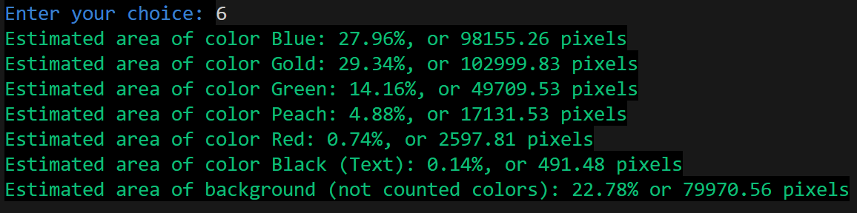
3.1.5 Determining Colored Regions
target_colors stores the colors of the dartboard
Then the sampling data is done with image_pixel_sampling_by_color()
The percentage area that each color takes up is calculated by determine_area()
Results are then printed
The amount of total pixels is also calculated (not shown in below ss)

Slide 26
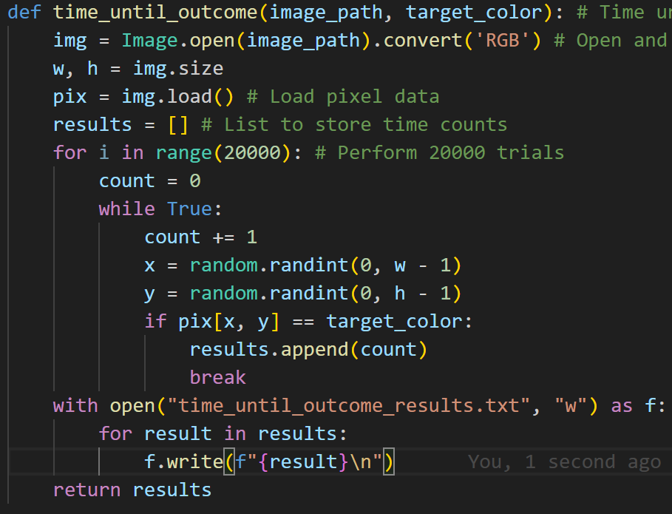
4. Distribution exploration
4.1.1. Time until outcome
Time_until_outcome() repeatedly samples pixels until the color is detected
This is repeated 20000 times, and the amount of times it took is stored in time_until_pixel_found
The results are also written into a txt file

Slide 27
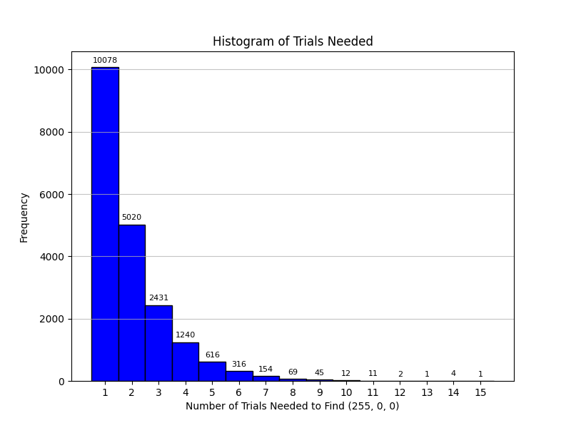
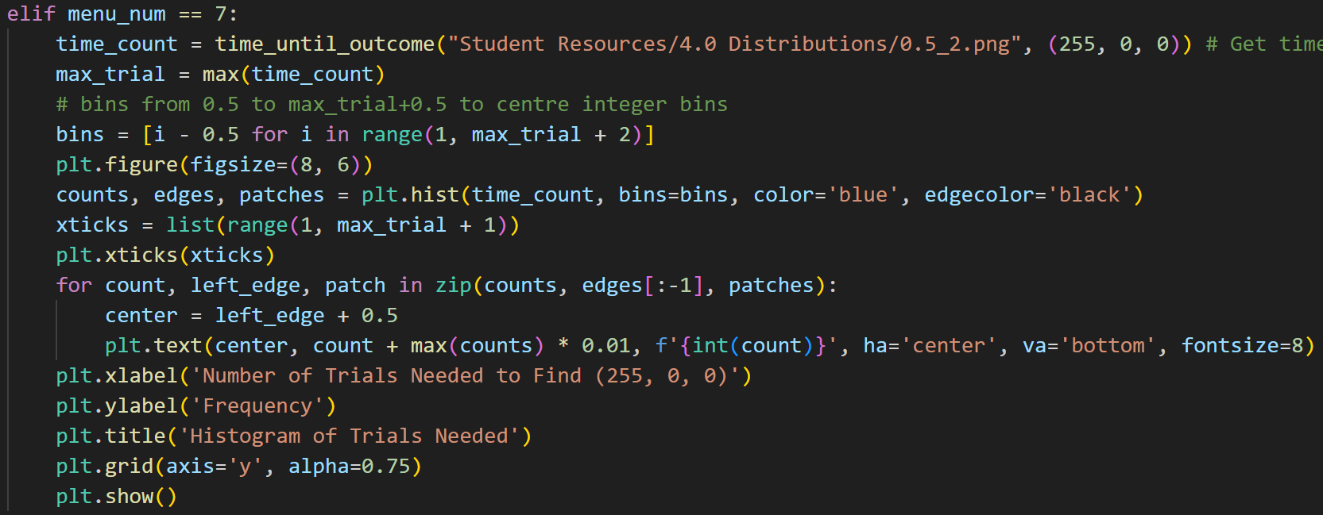
4.1.1. Time Until Outcome Results
This code graphs the results
I tried doing plt.hist(time_count) but it ended up not aligning the x values with the bars

Slide 28
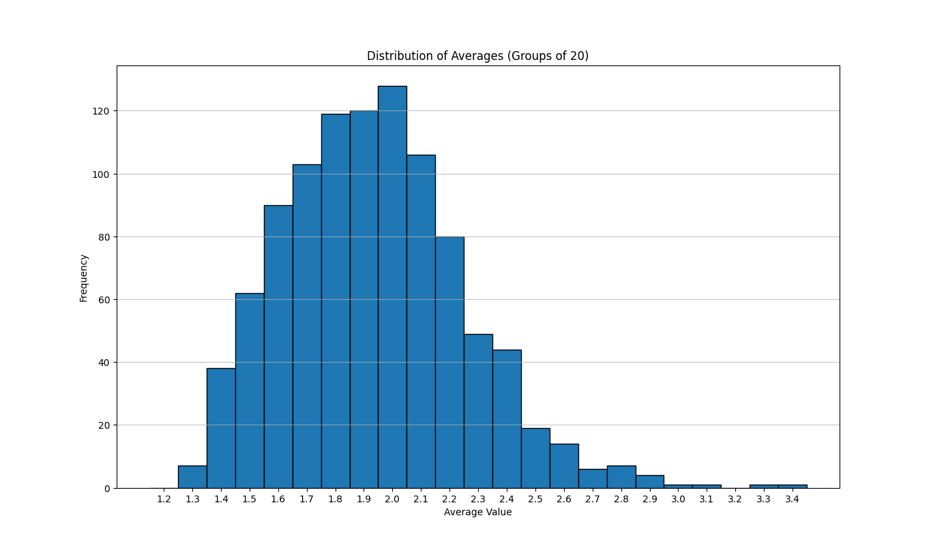
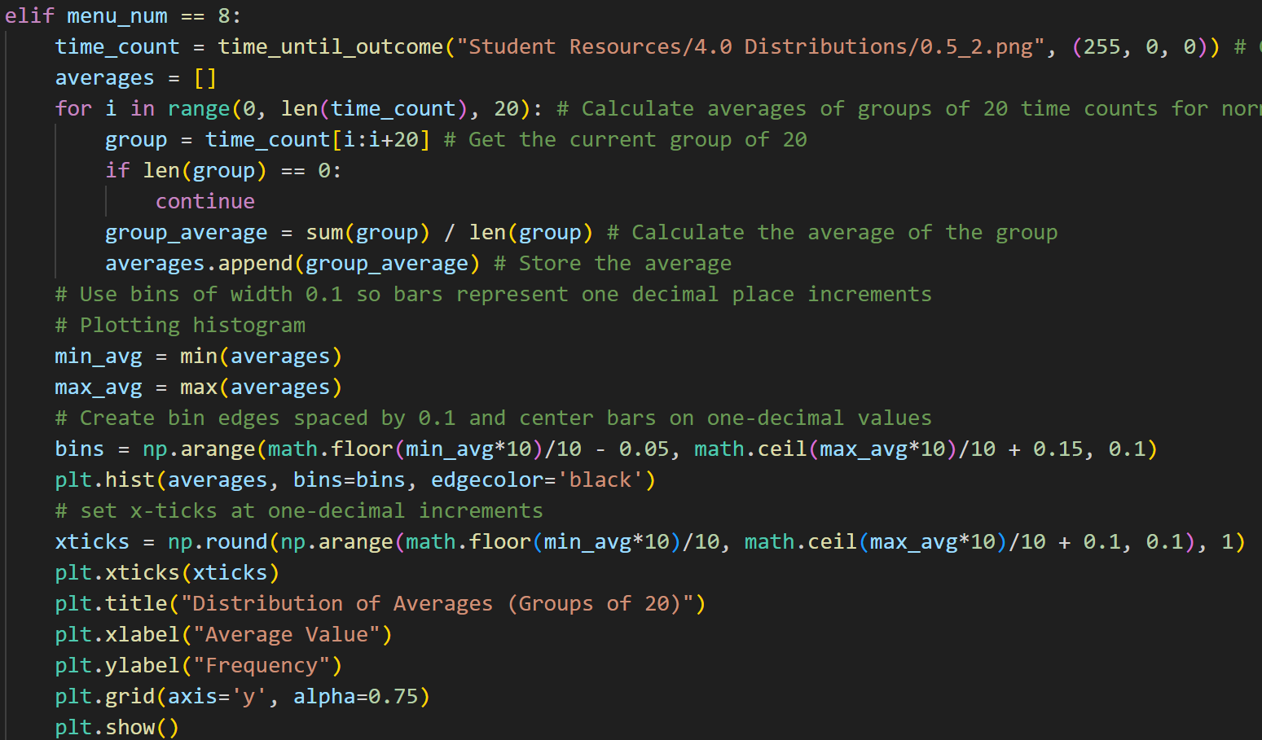
4.1.2. Average of Times
time_count[i:i+20] produces slices of 20 results each
They are averaged and graphed

Slide 29
4.1.3. Normal Distribution
Graph A - Geometric Distribution:
This graph shows the results from a geometric process, for example, how many times something had to happen before a success.
This data is not symmetrical, it usually has a skewed tail to the right.
In other words, most results are small numbers, but occasionally you get bigger ones.
Graph B - Averages of Groups:
For Graph B, instead of plotting all the individual results like in Graph A, the results were taken in groups.
Then, the average of each group was calculated.
So Graph B is made up of a bunch of averages.
The Central Limit Theorem says that when you take many averages of random results (even if those results are not normally distributed), the distribution of those averages will look like a normal (bell-shaped) curve

